Slide 1
Review of Object Oriented Development
Session 25
(Lecture)
Course : Program Design Methods
Effective Period : July 2018

Slide 2
These slides have been adapted from
Britton, C.. (2005). A student Guide to Object Oriented Development. 01. Butterworth-Heinemann. Amsterdam. ISBN: 978-0-7506-6123-2.
Acknowledgement

Slide 3
LO 5 : Explain the object oriented design
LO 6 : Design the application using the object oriented design
Learning Objectives

Slide 4
Contents
Use Case Diagram
Class Diagram
Interaction Diagram
Sequence Diagram
Collaboration Diagram
State Diagram
Activity Diagram
Implementation Diagram
Component Diagram
Deployment Diagram

Slide 5
Use Case Diagram
Use case model the user’s view of functionality of a system
The use case model provide a means of organizing, structuring, and documenting the mass of information during requirement elicitation
The use case model consist of a use case diagram, a set of use case description and a set of scenarios
The use case diagram models the problem domain graphically using four concepts : the use case, the actor, the relationship link and the boundary.

Slide 6
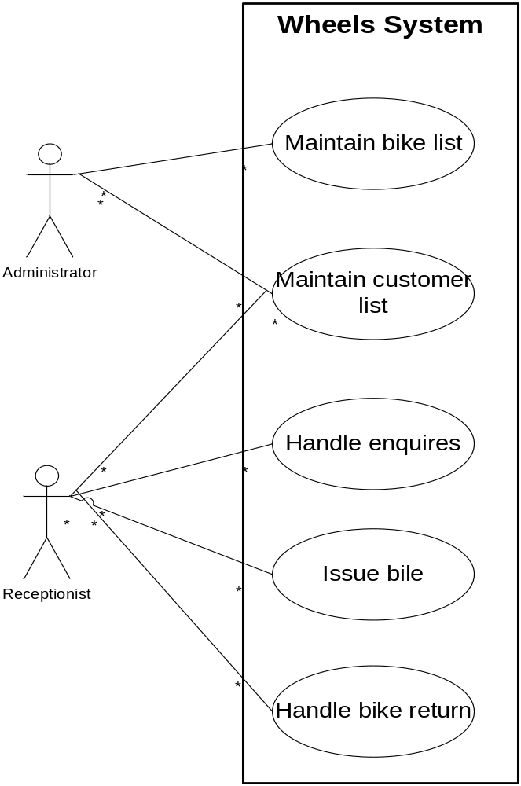
Example
The functionality of the new system has been divided into five use cases :’Maintain bike list’, ‘Maintain customer list’, ‘Handle enquires’, ‘Issue bike’, and ‘Handle bike return’
The actor, represented by a stick figure, is the person who uses the system in the way specified in the use case

Slide 7
Class Diagram
The class diagram is used to model classes and the relationship between classes, and also to model higher-level structures comprising collections of classes grouped into packages

Slide 8
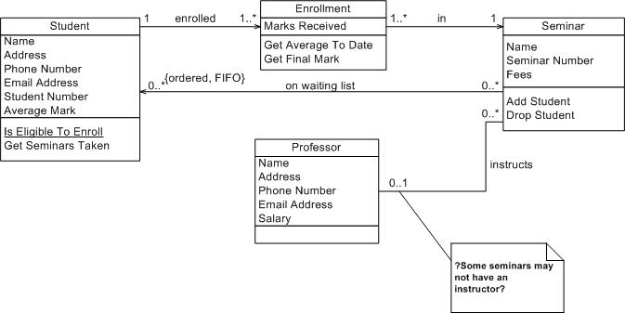
Example

Slide 9
Interaction Diagram
Interaction diagram model the messaging between a collaboration of objects that will take place in the execution of a specific scenario
There are two types of interaction diagram
  Sequence Diagrams
  Collaboration Diagrams

Slide 10
Sequence Diagram
Sequence diagrams show clearly and simply the flow of control between objects required to execute a scenario
A scenario outlines the sequence of steps in one instance of a use case from the user’s side of the computer screen, a sequence diagram shows how these steps translate into messaging between objects on the computer’s side of the screen

Slide 11
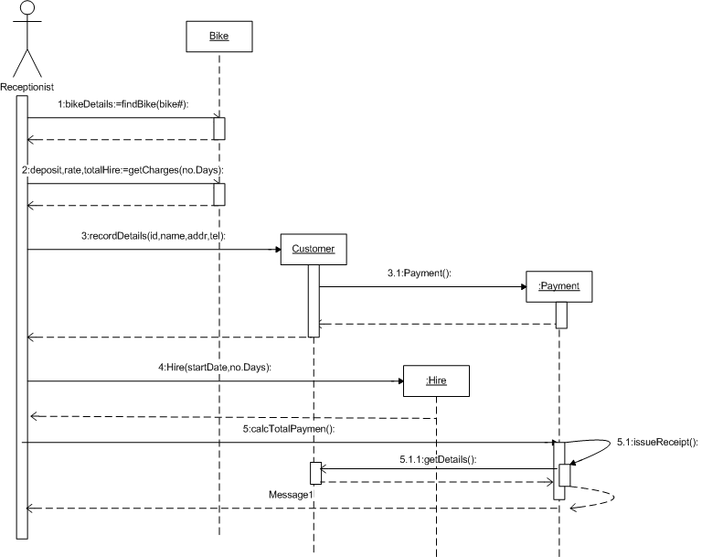

Slide 12
Collaboration Diagram
The collaboration diagram almost same with the sequence diagram, but the difference are :
  Messages are not shown in time sequence, so numbering becomes essential to indicate the order of the messages
  Links between objects are explicitly modeled, which is not the case with the sequence diagram
  Messages are grouped together on the object links
  Messages are shown as text labels with an arrow that points from the client to the server
  Return are never modeled in a collaboration diagram

Slide 13
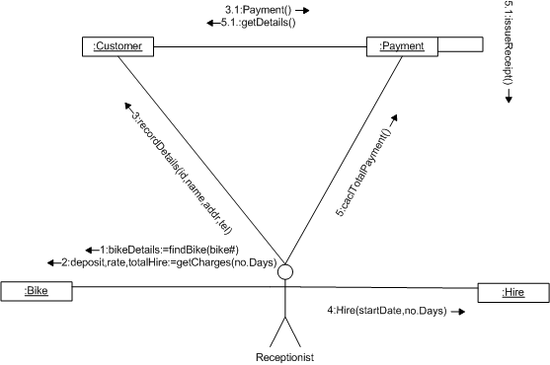

Slide 14
State Diagram
A state diagram models the different states that objects of a class can be in, and the events that cause an object to move from one state to another. In order to be able to draw these diagrams, we therefore need to understand what is meant by state and event in this context.

Slide 15
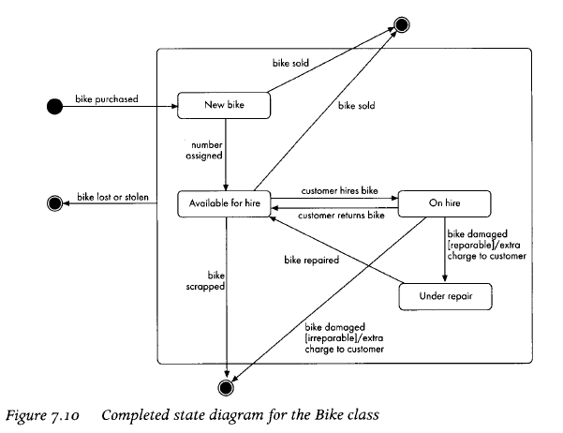
Example

Slide 16
Activity Diagram
In activity diagram, the states are activities and the transition between them are triggered by the completion of the activity rather than by an external event
Activity diagrams show the internal flow of control in a process.
Activity diagrams can be used to represent sequence, selection and iteration and they can also illustrate where different activities can be carried out in parallel.

Slide 17
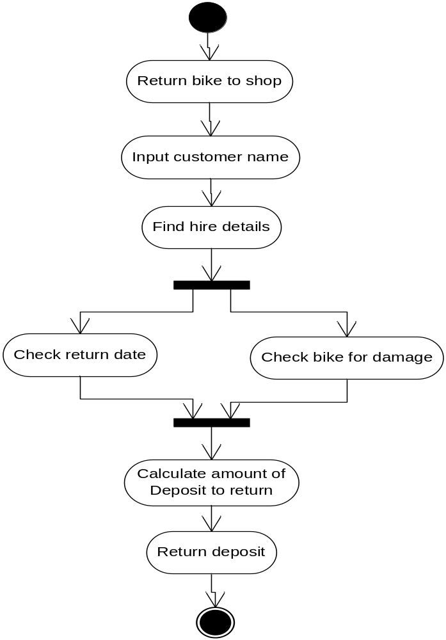
Example

Slide 18
Implementation Diagram
There are two type of implementation diagram in this stage : component diagrams and deployment diagrams
The component diagram describes the physical software components of the system and their dependencies : such things as executable files, databases, and libraries of classes
The deployment diagram shows the hardware components of the system, i.e computers and their peripherals.

Slide 19
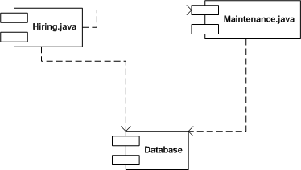
Component Diagram

Slide 20
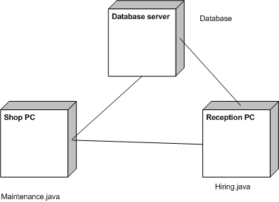
Deployment Diagram

Slide 21
References
A student guide to object-oriented development, Chapter 1 -11

Slide 22
Q & A

